Slide 1

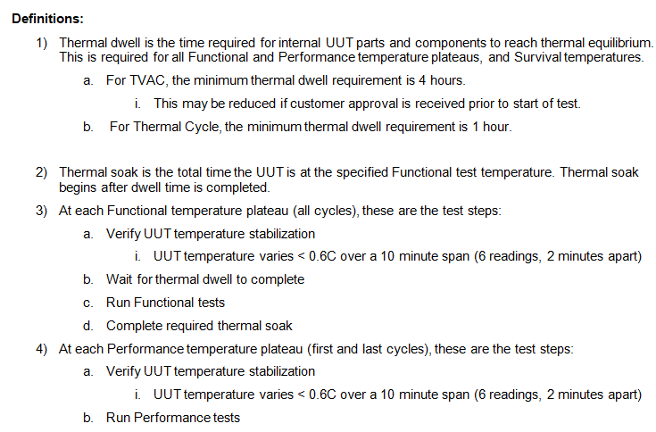
Lynx TVAC and Temp Cycle Spec.

Slide 2
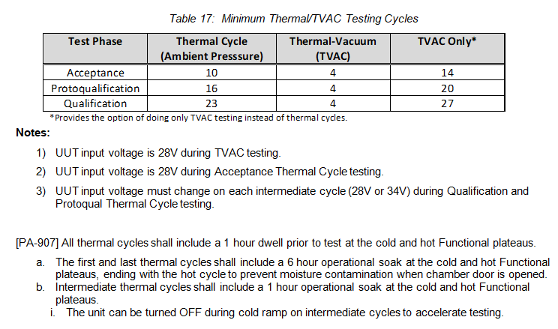
Lynx TVAC and Temp Cycle Spec.

Slide 3
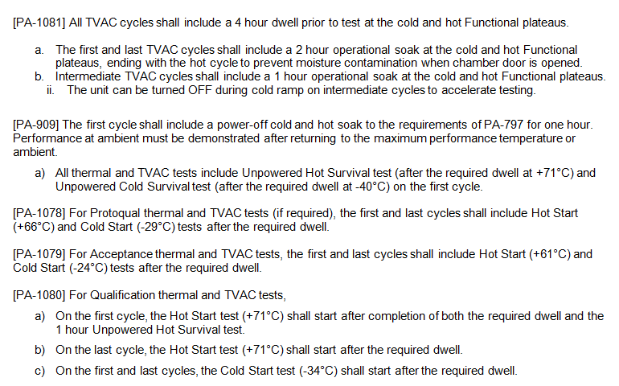
Lynx TVAC and Temp Cycle Spec.

Slide 4
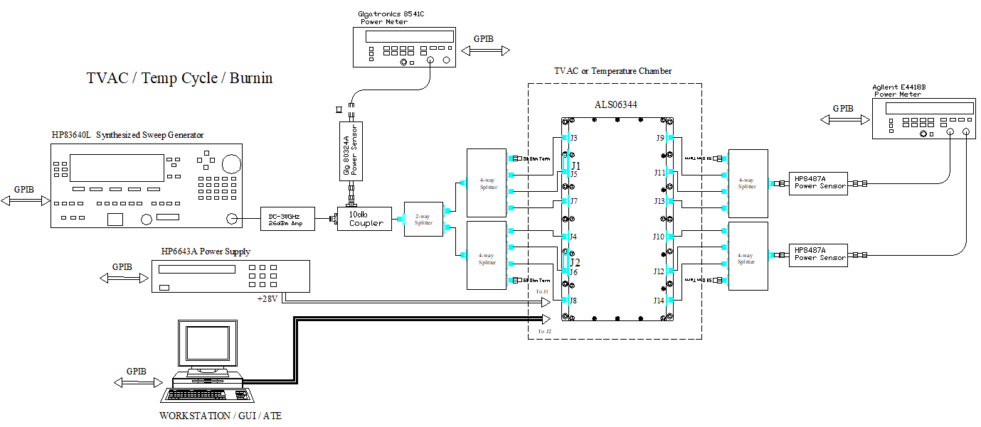
Lynx TVAC and Temp Cycle Set-up
Only the ALS06344 DUT will be in the chamber
RF in/out cables and DC/Control wires will be routed thru the chamber feed-thru
Calibrated input CW power of -10dBm into each of the modules will be implemented by using 2-way and 4-way splitters
2 sets of 4-way splitters will be used to monitor the output power of each module; 1 splitter to measure the horizontal amplifier modules and 1 splitter for the vertical amplifier modules
ATE software will perform the following:
Thru the DUT control interface:
send band select and gain commands to the DUT and record mtemp telemetry and other telemetry.
Thru the GPIB interface:
Measure and store input / output offsets for each amplifier path
Set input power
Record input and output power for each amplifier path
Record current draw

Slide 5
Lynx TVAC and Temp Cycle Set-up
Measure input splitter offsets from coupled port to each of the 6 splitter outputs. These are the input power meter offsets used to set input power of -10dBm for each of the 6 amplifier modules and save the input splitter offsets into the ATE.
Measure output splitter offsets to each of the output splitter inputs. These are the output power meter offsets used to measure output power of each amplifier module and save the output splitter offsets into the ATE.
Recall J3 input offset and J9 output offset to measure band 1 horizontal amplifier module
Set the DUT to enable band 1 and gain to max value
Set signal generator CW freq to 3 GHz and turn on RF power
Adjust signal generator power level to obtain input power level of -10dBm
Record input power reading from input power meter into ‘Band 1 Horizontal input power’ in the test data log.
Record output power reading from output power meter channel 1 into ‘Band 1 horizontal output power’ in the test data log.
Record current draw from the power supply and mtemp output of the DUT
Repeat above steps for the remaining input/output ports, bands and CW frequencies outlined in the table below
The ATE will continuously execute all the above steps through the entire duration of the temp / TVAC cycles
Input port | Output Port | Band | CW Freq | Output power meter Channel # | Input power data log (input power meter) | Output power data log (output power meter)
J3 | J9 | 1 | 3 GHz | 1 | Band 1 horizontal | Band 1 horizontal
J5 | J11 | 2 | 12.5 GHz | 1 | Band 2 horizontal | Band 2 horizontal
J7 | J13 | 3 | 28 GHz | 1 | Band 3 horizontal | Band 3 horizontal
J4 | J10 | 1 | 3 GHz | 2 | Band 1 vertical | Band 1 vertical
J6 | J12 | 2 | 12.5 GHz | 2 | Band 2 vertical | Band 2 vertical
J8 | J14 | 3 | 28 GHz | 2 | Band 3 vertical | Band 3 vertical

Slide 6
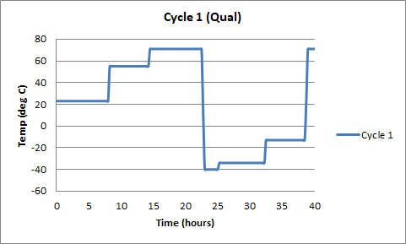
Aldetec Temp Cycling (Cycle 1, Qual)
3
7
2
1
6
4
5
Temperature profile for cycle 1
Step 1
Performance tests and characterization data at 23°C plateau
UUT (34V)
RF output with -10 dBm input (OQPSK waveform) in High Gain state (each band)
Maximum gain in Low Gain state (each band)
Command & response, operating modes, RF output stabilization
Power consumption (each band)
Voltage and temperature telemetry with timestamps
UUT (28V)
RF output with -10 dBm input (OQPSK waveform) in High Gain state (each band)
Maximum gain in Low Gain state (each band)
Spectral Emissions (each band)
Gain and phase characterization data for each attenuator setting (each band)
Command & response, operating modes, RF output stabilization
Power consumption (each band)
Voltage and temperature telemetry with timestamps

Slide 7
Aldetec Temp Cycling (Cycle 1, Qual)
Step 2
Performance tests and characterization data at 55°C plateau (28V)
RF output with -10 dBm input (OQPSK waveform) in High Gain state (each band)
Maximum gain in Low Gain state (each band)
Spectral Emissions (each band)
Gain and phase characterization data for each attenuator setting (each band)
Command & response, operating modes, RF output stabilization
Power consumption (each band)
Voltage and temperature telemetry with timestamps
Step 3
Functional tests and characterization data at 71°C plateau (28V)
1-hr dwell powered-on
1-hr hot survival unpowered
Hot start test
Functional tests
RF output with -10 dBm input (CW input) in High Gain state (each band)
Command & response, operating modes, RF output stabilization
Power consumption (each band)
Voltage and temperature telemetry with timestamps
6-hr soak powered-on
Step 4
Cold survival at -40°C plateau
1-hr dwell unpowered
1-hr cold survival unpowered
Step 5
Functional tests and characterization data at -34°C plateau (28V)
1-hr dwell powered-on
Cold start test
Functional tests
RF output with -10 dBm input (CW input) in High Gain state (each band)
Command & response, operating modes, RF output stabilization
Power consumption (each band)
Voltage and temperature telemetry with timestamps
6-hr soak powered-on

Slide 8
Aldetec Temp Cycling (Cycle 1, Qual)
Step 6
Performance tests and characterization data at -13°C plateau (28V)
RF output with -10 dBm input (OQPSK waveform) in High Gain state (each band)
Maximum gain in Low Gain state (each band)
Spectral Emissions (each band)
Gain and phase characterization data for each attenuator setting (each band)
Command & response, operating modes, RF output stabilization
Power consumption (each band)
Voltage and temperature telemetry with timestamps
Step 7
Ramp to 71°C and stabilize

Slide 9
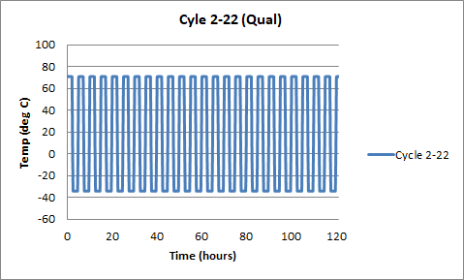
Aldetec Temp Cycling (Cycles 2-22, Qual)
Temperature profile for cycles 2-22
Prior to start of cycle 2, the test set-up will be configured for the automated test set-up shown in slide 2.
The temperature chamber will be configured to the above temperature cycle profile
Ramp rate of 4 °C / min
1-hour dwell + 1-hour soak at each plateau
The automated test set-up will be perform the following steps continuously through the entire temperature cycle profile:
Log Pin and Pout CW data for each amplifier module at high-gain state
Log DC power consumption for each band
Log voltage and temperature telemetry with timestamps
Apply +28V to UUT for even-numbered cycles
Apply +34V to UUT for odd-numbered cycles
Switch bands every 10 minutes and continuously log data

Slide 10
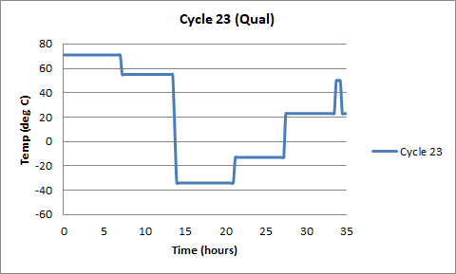
Aldetec Temp Cycling (Cycle 23, Qual)
1
6
2
5
7
4
3
Temperature profile for cycle 23
Step 1
Functional tests and characterization data at 71°C plateau (28V)
1-hr hot survival unpowered
Hot start test
Functional tests
RF output with -10 dBm input (CW input) in High Gain state (each band)
Command & response, operating modes, RF output stabilization
Power consumption (each band)
Voltage and temperature telemetry with timestamps
6-hr soak powered-on

Slide 11
Aldetec Temp Cycling (Cycle 23, Qual)
Step 2
Performance tests and characterization data at 55°C plateau (28V)
RF output with -10 dBm input (OQPSK waveform) in High Gain state (each band)
Maximum gain in Low Gain state (each band)
Spectral Emissions (each band)
Gain and phase characterization data for each attenuator setting (each band)
Command & response, operating modes, RF output stabilization
Power consumption (each band)
Voltage and temperature telemetry with timestamps
Step 3
Functional tests and characterization data at -34°C plateau (28V)
1-hr dwell unpowered
Cold start test
Functional tests
RF output with -10 dBm input (CW input) in High Gain state (each band)
Command & response, operating modes, RF output stabilization
Power consumption (each band)
Voltage and temperature telemetry with timestamps
6-hr soak powered-on
Step 4
Performance tests and characterization data at -13°C plateau (28V)
RF output with -10 dBm input (OQPSK waveform) in High Gain state (each band)
Maximum gain in Low Gain state (each band)
Spectral Emissions (each band)
Gain and phase characterization data for each attenuator setting (each band)
Command & response, operating modes, RF output stabilization
Power consumption (each band)
Voltage and temperature telemetry with timestamps Step 5

Slide 12
Aldetec Temp Cycling (Cycle 23, Qual)
Step 5
Performance tests and characterization data at 23°C plateau (28V)
RF output with -10 dBm input (OQPSK waveform) in High Gain state (each band)
Maximum gain in Low Gain state (each band)
Spectral Emissions (each band)
Gain and phase characterization data for each attenuator setting (each band)
Command & response, operating modes, RF output stabilization
Power consumption (each band)
Voltage and temperature telemetry with timestamps
Step 6
Ramp up to 50°C and soak for 30 min (bake-out)
Step 7
Ramp down to 23°C

Slide 13
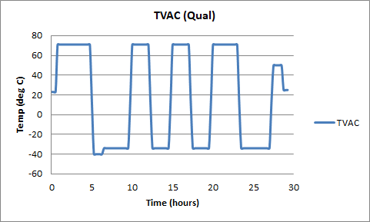
TVAC Temp Cycling (Qual)
1
5
7
8
2
3
4
6
TVAC Temperature profile
Step 1
Functional tests and characterization data at 71°C plateau (28V)
1-hr hot survival unpowered
Hot start test
Functional tests
RF output with -10 dBm input (CW input) in High Gain state (each band)
Command & response, operating modes, RF output stabilization
Power consumption (each band)
Voltage and temperature telemetry with timestamps
2-hr soak powered-on ( 40 minutes in each band)
Turn off DUT after 2 hr soak and then go cold step 2.
May have chamber temperature controller set at all plateaus longer ( i.e. 15 – 20 min) to ensure the oven controller does not change temperature too soon.

Slide 14
TVAC Temp Cycling (Qual)
Step 2
Cold survival at -40°C plateau
1-hr dwell unpowered
1-hr cold survival unpowered
Step 3
Functional tests and characterization data at -34°C plateau (28V)
1-hr dwell unpowered
Cold start test
Functional tests
RF output with -10 dBm input (CW input) in High Gain state (each band)
Command & response, operating modes, RF output stabilization
Power consumption (each band)
Voltage and temperature telemetry with timestamps
2-hr soak powered-on ( DUT remains on until the end of step 4).
Step 4
Functional tests and characterization data in cycles 2-3 (28V)
1-hour dwell + 1-hour soak at each plateau
The automated test set-up will be perform the following steps continuously through the entire temperature cycle profile:
Log Pin and Pout CW data for each amplifier module at high-gain state
Log DC power consumption for each band
Log voltage and temperature telemetry with timestamps
Dwell time for each selected band will be 10 minutes prior to data log
Step 5
Functional tests and characterization data at 71°C plateau (28V)
1-hr hot survival unpowered
Hot start test
Functional tests
RF output with -10 dBm input (CW input) in High Gain state (each band)
Command & response, operating modes, RF output stabilization
Power consumption (each band)
Voltage and temperature telemetry with timestamps
2-hr soak powered-on
Turn off DUT after 2 hr soak and then go cold step 6.

Slide 15
TVAC Temp Cycling (Qual)
Step 6
Functional tests and characterization data at -34°C plateau (28V)
1-hr dwell unpowered
Cold start test
Functional tests
RF output with -10 dBm input (CW input) in High Gain state (each band)
Command & response, operating modes, RF output stabilization
Power consumption (each band)
Voltage and temperature telemetry with timestamps
2-hr soak powered-on
Turn off DUT after 2 hr soak and then go step 7.
Step 7
Ramp up to 50°C and soak for 30 min (bake-out)
Step 8
Ramp down to 23°C

